Slide 1


Ain Shams University
Faculty of Computer and Information Sciences Information Systems Department
DataForge
Automated Data Warehouse Schema Generator with AI-Driven Enhancements

Slide 2
Team members
Abdelrahman Abdelnasser Gamal Mohamed
Abdelrahman Adel Atta Mohamed
Ahmed Reda Mohamed
Ahmed Mahmoud Mohamed
Arwa Amr Elsharawy
Alaa Emad Abd ElSalam ElSayed
Under Supervision of
Dr. Yasmine Afify
TA. Yasmine Shaaban

Slide 3
Table of Contents
Introduction
Problem Statement
Objective
System Architecture
Functions & Non Functional
Use Case
Algorithms And Techniques
Datasets
Experimental Results
Demo

Slide 4
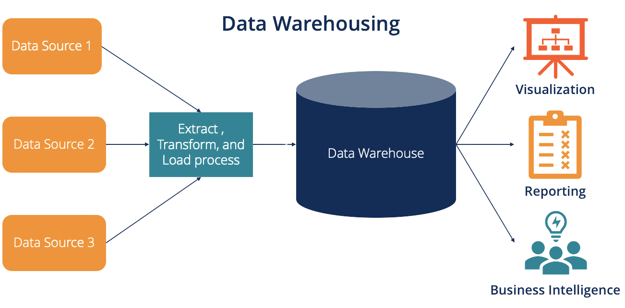
Introduction
A data warehouse is a centralized repository that stores large volumes of data from multiple sources, enabling efficient analysis and reporting.
Key Features:
Integration.
Historical Data Storage.
Optimized for Querying.
1
Notes:
Integration: Combines data from various operational systems (e.g., sales, marketing, finance) into a unified format.
Historical Data Storage: Maintains historical records, allowing for trend analysis over time.
Optimized for Querying: Designed to handle complex queries and large-scale data analysis quickly.

Slide 5
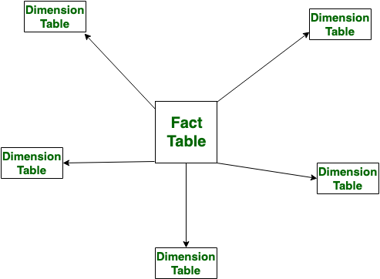
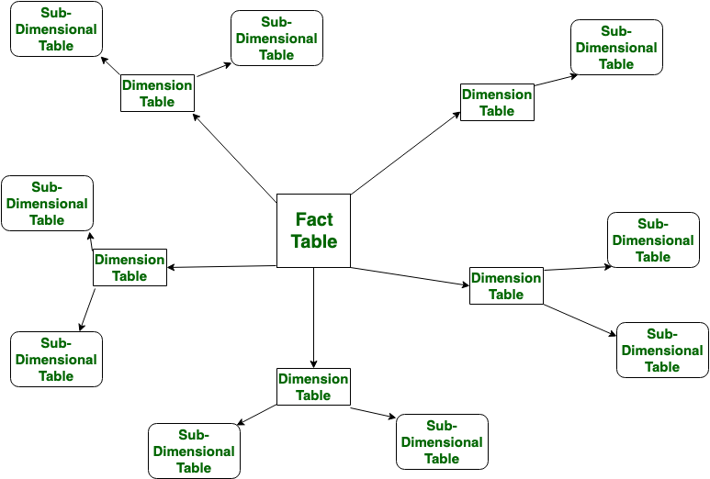
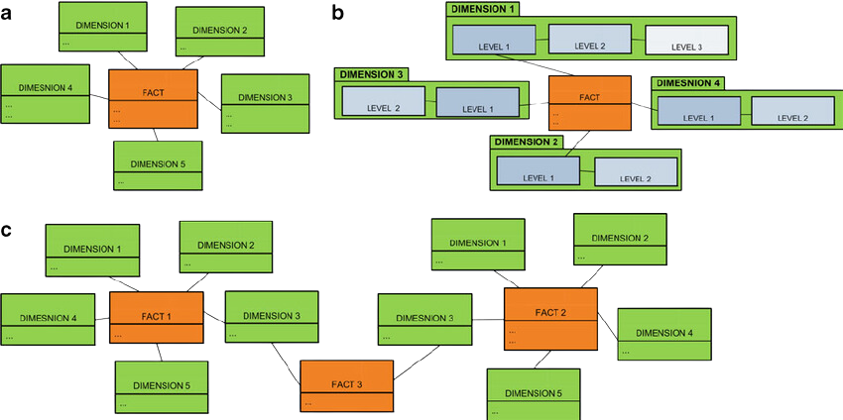
Data Warehouse Schema Types
SnowFlake Schema
Galaxy Schema
Star Schema
2

Slide 6
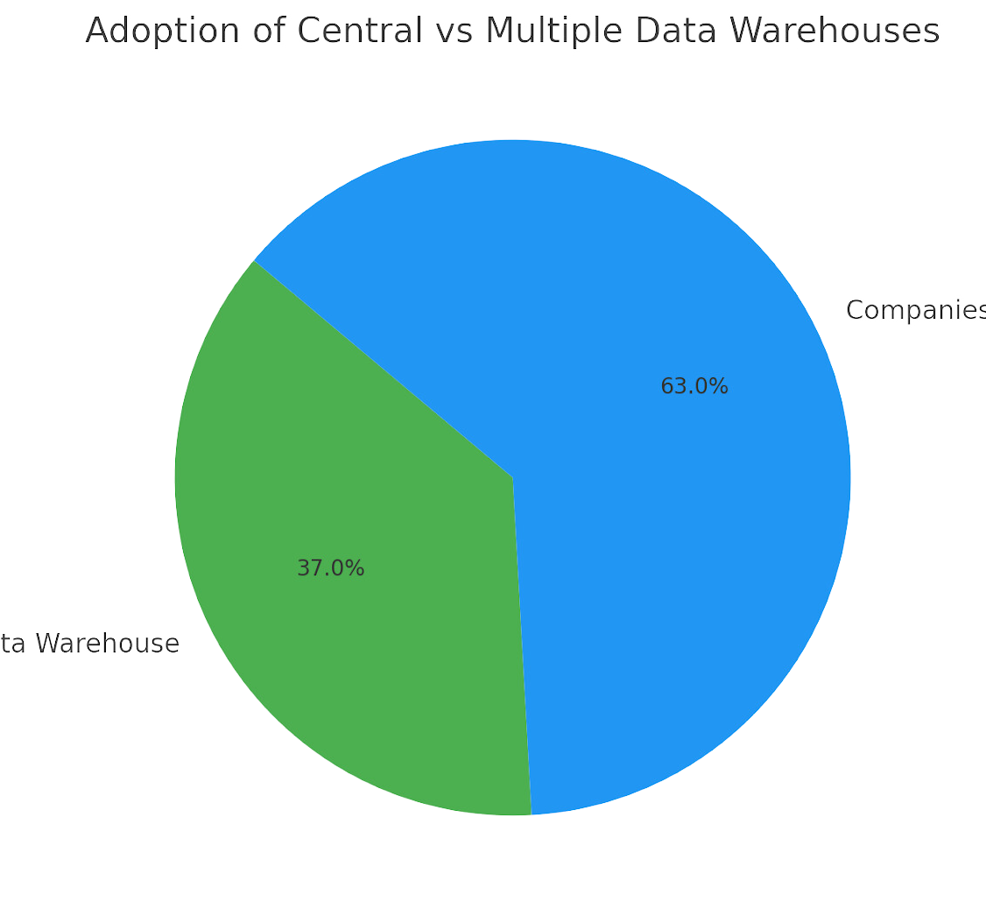
Introduction
Data-Driven Decision Making:
In today’s business landscape, data warehouses are essential for consolidating and analyzing vast amounts of information from diverse sources.
Current Adoption Rates:
37% of companies have a central data warehouse.
A significant 63% of organizations utilize multiple data warehouses.
https://www.existbi.com/blog/key-statistics-data-warehouse/
3

Slide 7
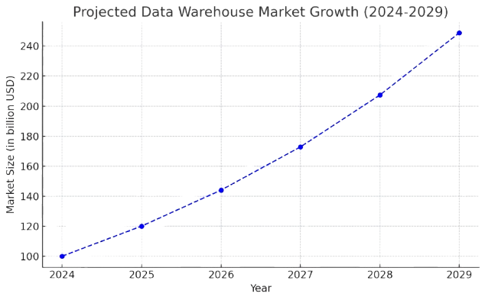
Introduction
Duration:
Data warehouse implementation typically takes 6-9 months.
Cost: Initial implementation costs start at around $70,000, with larger projects ranging up to $485,000.
Market Growth:
The data warehouse market is projected to grow by 20% annually over the next five years.
https://data-vault.com/data-warehouse-market-size/
3

Slide 8
Time-Consuming Process: Manually parsing SQL files and designing schemas
Problem Definition
Human Error: Mistakes in identifying relationships or defining keys
Designing data warehouse schemas involves identifying and organizing fact and dimension tables, defining primary and foreign keys, and ensuring consistency across various data sources.
Scalability Issues: As data volumes increase, manually designing becomes impractical
Manual schema generation poses several challenges.
Lack of Optimization: Without automated tools, optimizing schemas for performance and scalability is challenging
4

Slide 9
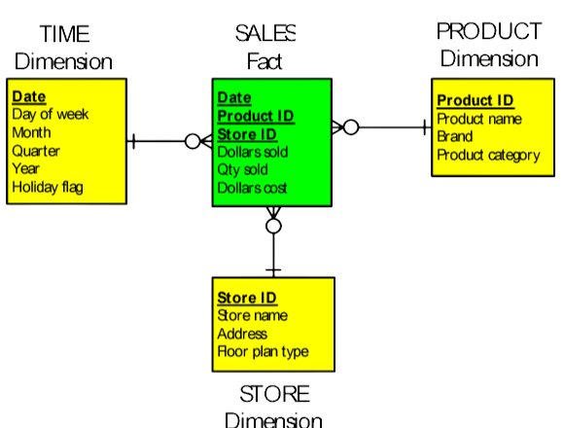
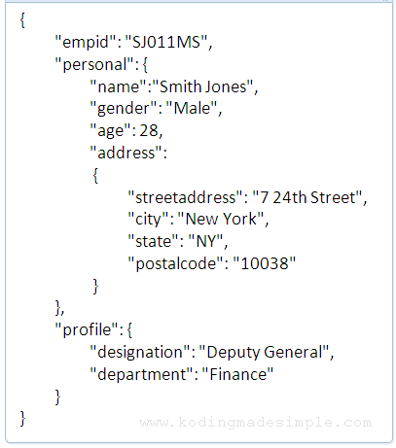

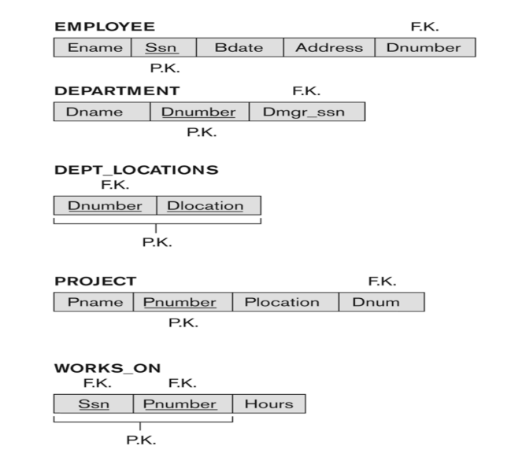
Objective
The objective of the DataForge project is to develop an automated tool that streamlines the creation of data warehouse schemas.
5

Slide 10
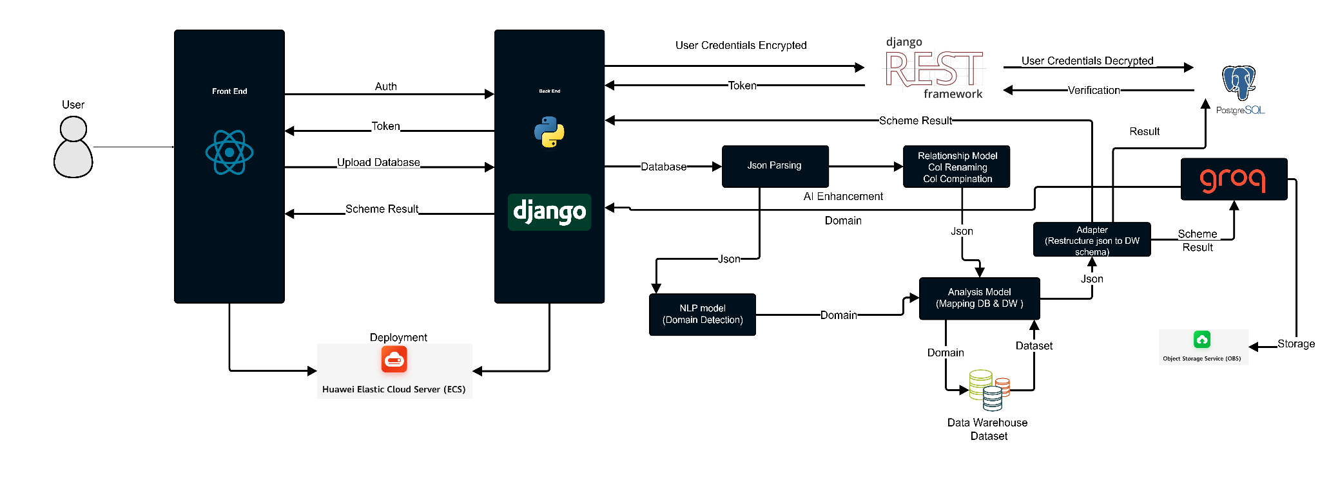
System Architecture
Schema Result
Schema Result
Schema
Result
6

Slide 11
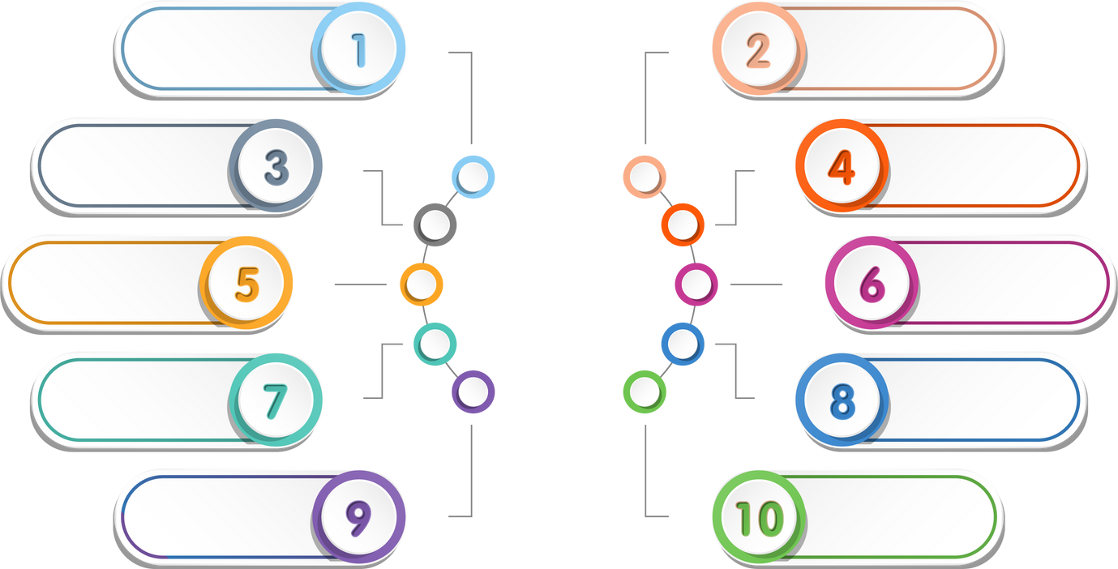
Functional Requirements
User Authentication
Schema Upload & parsing
Domain Detection
Schema Generation
Data
Forge
Schema Visualization
AI Enhancements
Schema Editing
Versioning & Undo
Metadata Management
Export & Reporting
7

Slide 12
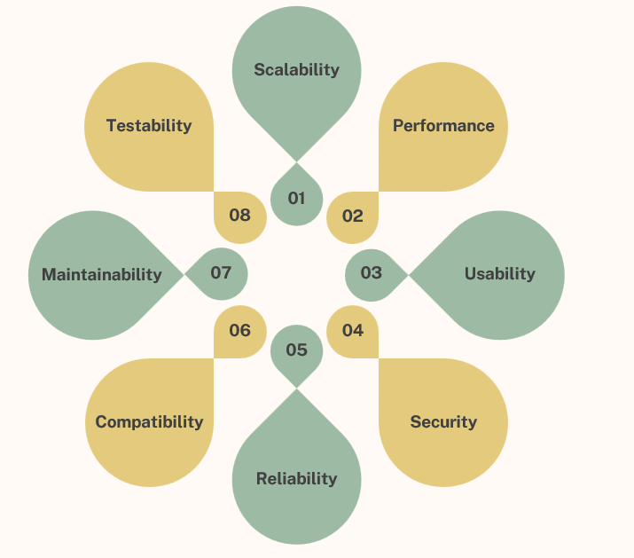
Non-Functional Requirements
8

Slide 13
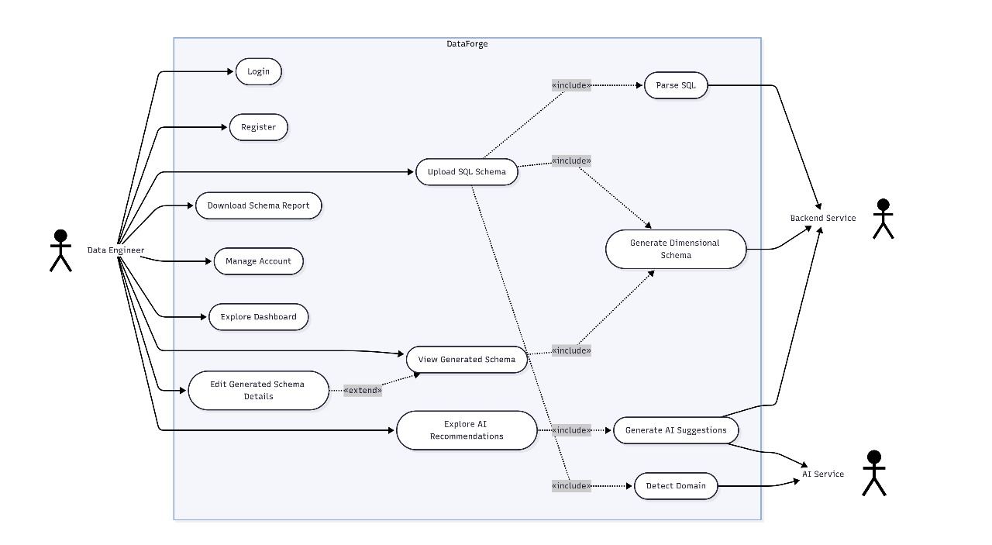
Use Case
9

Slide 14
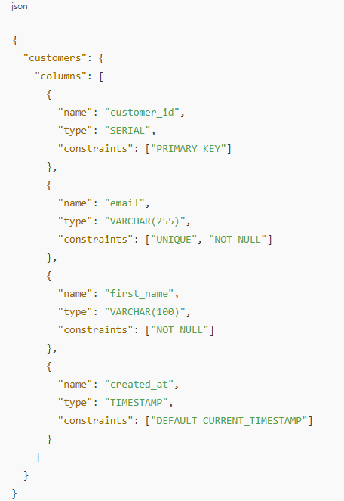
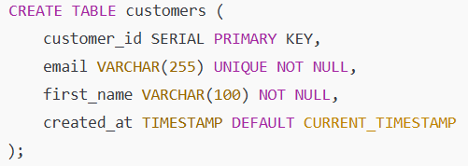
Algorithms And Techniques
01 Regex-Based SQL Parsing
Finite State Machine + Pattern Matching
10
Notes:
We already used AST Normalization and regex-based and found regex-based is faster

Slide 15







Algorithms And Techniques
01 Regex-Based SQL Parsing
01
02
03
04
05
06
Normalize Input
Pattern Detection
Content Extraction & Parsing
Component Splitting
Classification
JSON Generation
Remove comments, standardize whitespace
Find CREATE TABLE statements using regex
Extract table definitions and handle nested parentheses using stack-based logic
Separate columns and constraints by commas
Categorize as column level or table-level constraints
Structure output as JSON schema
11

Slide 16

Algorithms And Techniques
01 Regex-Based SQL Parsing
Fast & Efficient: 3–5× faster than AST-based parsers
Lightweight & Integration-Friendly: Minimal memory use, no external libraries
Robust & Reliable: Covers 97% of SQL DDL edge cases
Flexible Across SQL Dialects: Regex-based logic adapts easily to variations in SQL syntax, avoiding strict grammar limitations.
12

Slide 17
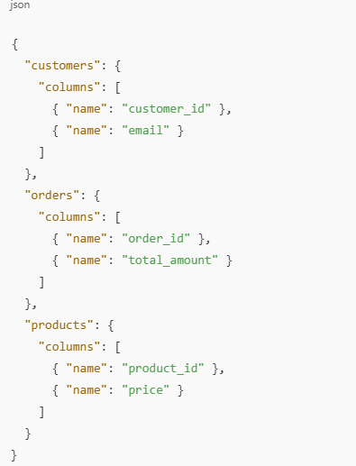
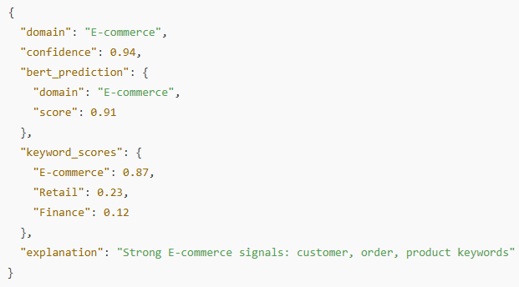
Algorithms And Techniques
02 BERT Fine-tuned Domain Detection
Hybrid Neural Network + Rule-Based Classifier
13

Slide 18

Algorithms And Techniques
01 Regex-Based SQL Parsing
02 BERT Fine-tuned Domain Detection
Text Extraction from schema
01
02
Tokenization via BERT
Feature Engineering
03
04
Neural Classification
Confidence Scoring
05
06
Confidence Scoring
Hybrid Decision Making
07
14

Slide 19
Algorithms And Techniques
02 Keyword-Based Domain Detection
02 BERT Fine-tuned Domain Detection
Accurate & Explainable: Achieves 92% classification accuracy with clear.
Context-Aware Intelligence: Leverages BERT to understand naming context, enabling accurate and adaptable schema interpretation.
Fast & Real-Time Ready: Optimized for quick inference, making it suitable for real-time domain detection tasks.
Scalable & Domain-Agnostic: Combines ML and rule-based logic to support diverse domains with minimal retraining and high generalizability.
15

Slide 20
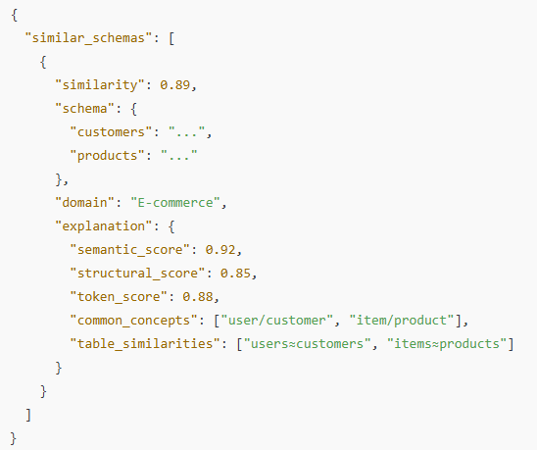
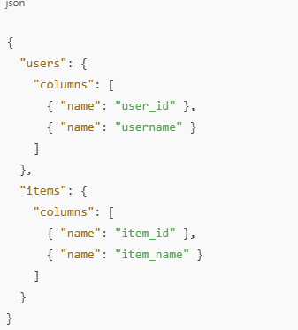
Algorithms And Techniques
03 Vector Similarity Matching
Multi-Modal Similarity Search + FAISS Indexing
16

Slide 21
Algorithms And Techniques
03 Vector Similarity Matching
Schema Vectorization
01
02
Multi-Modal Encoding
FAISS Index Construction
03
04
Query Vector Generation
Cosine Similarity Search
05
06
Score-Based Ranking
Match Explanation
07
17

Slide 22
Algorithms And Techniques
03 Vector Similarity Matching
Similarity Weights: Semantic: 50% Structural: 30% Token-based: 20%
Fast & Scalable: Enables rapid similarity search even across large schema libraries.
Smart Learning: Learns from existing high-quality schemas to improve matching over time.
Schema Reuse: Supports optimization by suggesting similar existing schema components.
18

Slide 23
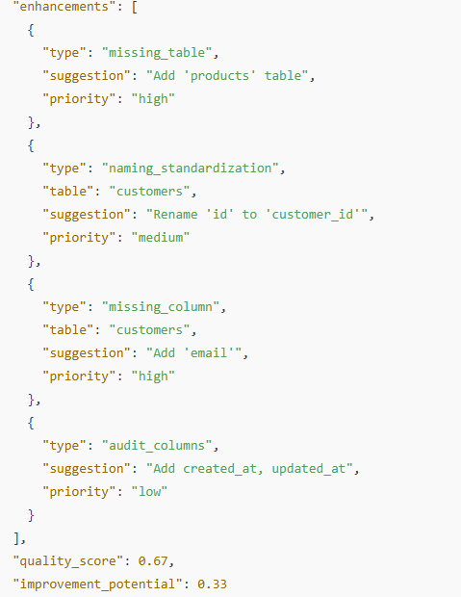
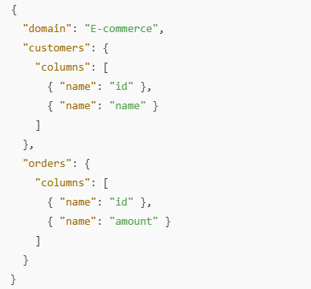
Algorithms And Techniques
04 Schema Standardization & Column Name Mapping
Pattern Matching + Set Operations + Domain Rules
19

Slide 24
Algorithms And Techniques
04 Schema Standardization & Column Name Mapping
Domain Rule Application
01
02
Gap Analysis
Pattern Matching
03
04
Quality Metrics Evaluation
Enhancement Suggestions
05
06
Constraint Recommendations
Integrity Validation
07
20

Slide 25
Algorithms And Techniques
04 Schema Standardization & Column Name Mapping
Structural Enhancement: Identifies missing tables or columns.
Naming Enhancement: Applies naming standardization.
Constraints Enhancement: Optimizes existing constraints and recommends additions.
Relationships Enhancement: Fixes or adds meaningful foreign key references.
21

Slide 26
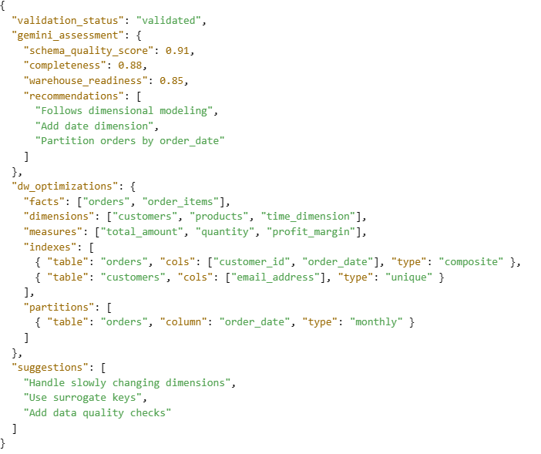
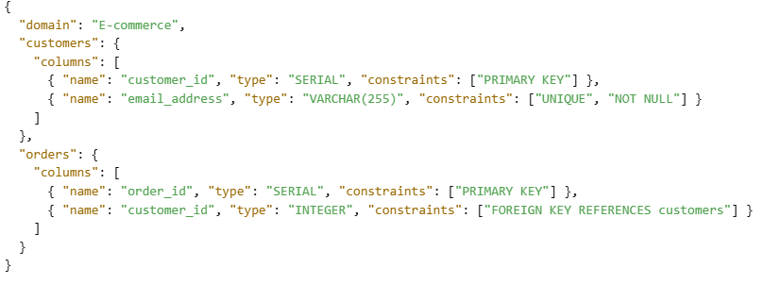
Algorithms And Techniques
05 Gemini Schema Validation & DW Enhancement
LLM-Based Validation + DW Optimization
22

Slide 27

Algorithms And Techniques
05 Gemini Schema Validation & DW Enhancement
LLM-Powered Schema Validation
01
02
DW-Readiness Scoring
OLAP Optimization Assessment
03
04
Dimensional Modeling Suggestions
Index & Partitioning Recommendations
05
06
Final Report Generation
23

Slide 28
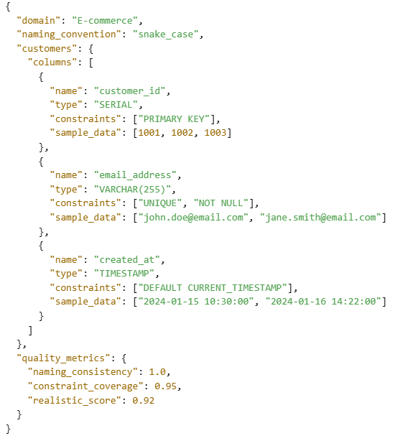
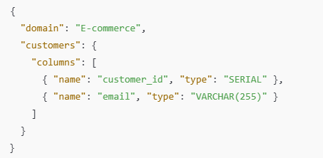
Algorithms And Techniques
06 Advanced Tokenization & Realistic Data Generation
Multi-Model Tokenization + Pattern Generation
24
Notes:
end of preprocessing

Slide 29
Algorithms And Techniques
06 Advanced Tokenization & Realistic Data Generation
Detect Naming Conventions
01
02
Identify Convention Type
Tokenize
03
04
Generate Realistic Names
Generate Sample Data
05
06
Consistency Validation
Final Schema Enhancement
07
25

Slide 30
Algorithms And Techniques
06 Advanced Tokenization & Realistic Data Generation
Models & Techniques Used:
Pattern-based Regex.
Semantic BERT WordPiece
Morphological Stemming (NLTK)
26

Slide 31
Algorithms And Techniques
07 Heuristic Schema Generation
01
02
03
04
FK Density
Numeric-Column Ratio
Cardinality Threshold
Grain Enforcement
FK cols/total ≥ 0.5 → fact
Ratio ≥ 0.6 numeric fields → reinforce fact classification
Dimension keys ≤ 10 % of fact cardinality
Ensures one row per event
27
Notes:
end of preprocessing

Slide 32
Datasets
Dataset | Domain | Notes
AdventureWorks DW | Manufacturing , Sales | Microsoft sample DW sales, purchasing, HR, inventory, and finance data.
Amazon Redshift Example | Sales | Illustrative schema for cloud data warehousing users, events, sales.
Peru Manufacturing DWH | Manufacturing | Kimball-based star schema for sales analysis; dimensions for product, time, and region.
Forest Inventory DWH | Environmental | Combines geospatial forest inventory and satellite image analysis.
28

Slide 33
Datasets
Dataset | Domain | Notes
Education Accreditation DWH | Educational | Supports BAN-PT accreditation and collaboration reporting (KERMA) includes student, publication, partnership data.
Pathogen Monitoring DWH | Healthcare/Public Health | Tracks pathogens, regions, facilities, and mitigation actions.
Steam User Behavior DWH | Gaming | Uses Steam API data; builds facts on playtime, achievements, purchases.
Orange Digital Center | Sales | Educational DW project includes customer, services, and performance logs.
29

Slide 34
Experimental Results
Hypotheses & End-to-End Metrics
Metric | Hypotheses | ShopSmart | TPC-DS | Prior Work
Parsing Accuracy (%) | ≥ 95 | 96 | 95 | ~ 90 % (DDL Parser)
Domain Detection (%) | ≥ 90 | 92 | 90 | 85 % (TF-IDF only)
Generation Time (s) | < 5 | 4.0 | 4.5 | 6.0s (Gupta & Jagadish)
Visualization Load (s) | < 3 | 2.0 | 2.3 | 4.0 s (VizSchema)
Edit Validation Accuracy (%) | ≥ 95 | 97 | 96 | N/A
User Satisfaction (1–5) | ≥ 4.0 | 4.2 ± 0.5 | 4.5 ± 0.5 | —
30
Notes:
TPC-DS stands for Transaction Processing Performance Council – Decision Support.
It is a standard benchmark used to evaluate the performance of data warehouse systems, especially for decision support workloads.

Slide 35
Experimental Results
03 Statistical Summaries
UAT (n=10): Mean 4.2, SD 0.5 90 % praised real-time validation.
04 Negative Findings
Healthcare Domain: Precision dipped to 88 %—resolved by richer metadata inclusion.
Cluster Controls: Users asked for manual expand/collapse—UI updated accordingly.
28

Slide 36
Experimental Results
01 Structural Similarity Analysis (SSA)
Measures how closely the generated schema preserves the original structure.
Table Count Similarity: Compares the number of tables.
Column Distribution: Checks average and variance of columns per table.
Data-Type Preservation: Verifies if column data types match.
Relationship Preservation: Ensures foreign keys are retained accurately.
31

Slide 37
Experimental Results
02 Semantic Coherence Scoring (SCS)
Evaluates how consistent, intuitive, and domain-appropriate the schema naming and organization is.
Naming Consistency: Uniform use of naming styles like snake_case, Dim_, Fact_.
Domain Relevance: Column/table names match domain vocabulary (e.g., customer_id in retail).
Logical Structure: Related fields are grouped logically within dimensions.
32

Slide 38
Experimental Results
03 Data-Warehouse Best Practices Compliance (DWBPC)
Measures adherence to established dimensional-modeling guidelines (Kimball/Ross).
Fact/Dimension Separation: Ensures numerical facts and descriptive dimensions are clearly separated.
Surrogate Keys: Presence of system-generated integer primary keys on all dimension tables.
SCD Support: Inclusion of columns needed for Slowly Changing Dimensions.
Date Dimension: Validates presence of a standard Date_Dim with full date hierarchy.
Audit Trails: Addition of created_at/updated_at timestamp fields on fact tables.
Foreign Keys: Proper FK constraints from facts to dimensions.
33

Slide 39
Experimental Results
04 Schema Quality Index (SQI)
An aggregate of four high-level quality dimensions:
1. Completeness: Are all original tables and columns present?
2. Consistency: Are naming and data-type patterns uniform across the schema?
3. Correctness: Do keys and relationships correctly enforce intended joins?
4.Conciseness: Is there minimal redundancy (no duplicate or unnecessary tables/columns)?
34

Slide 40
Experimental Results
05 Relationship Integrity Metric (RIM)
Measures the soundness and fidelity of inter-table relationships.
FK Consistency: Percentage of foreign-key constraints correctly specified.
Referential Integrity: Rate at which every FK value references an existing primary-key row.
Cardinality Appropriateness: Validation that the declared FK cardinalities (one-to-many vs. many-to-many) match the underlying data distributions.
Circular Reference Detection: Ensuring no unintended circular foreign-key chains.
35

Slide 41
Experimental Results
06 Domain Alignment Score (DAS)
Measures fit between the schema’s entities/attributes and the expected patterns and business rules of its domain.
Table Name Alignment: Use of domain-specific terms (e.g., Store_Dim, Sales_Fact in retail).
Column Name Alignment: Presence of standard columns (customer_id, order_date, etc.).
Business Rule Alignment: Encoding of domain logic (e.g., discount_percent vs. tax_rate in retail).
36

Slide 42
Experimental Results
Algorithmic Evaluation
Algorithm | DataForge | DataForge + AI-Enhancement
Structural Similarity Analysis | 98.50 % | 100.00 %
Semantic Coherence Scoring | 93.41 % | 98.48 %
Data-Warehouse Best Practices Compliance | 70.00 % | 75.56 %
Schema Quality Index | 94.69 % | 97.61 %
Relationship Integrity Metric | 85.93 % | 87.75 %
Domain Alignment Score | 88.40 % | 95.00 %
37

Slide 43
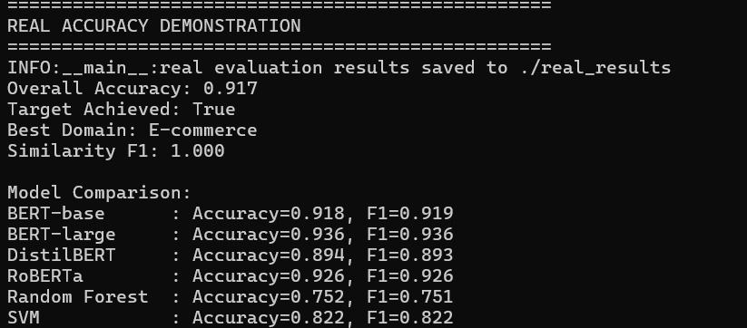
Experimental Results
Model Accuracy
38

Slide 44
Challenges
01 Inconsistent SQL Dialect Parsing
Problem:
The regex-based SQL parser struggled with varying SQL dialects (e.g., PostgreSQL vs. MySQL) and complex DDL structures in ShopSmart’s schema, such as nested constraints or non-standard syntax (e.g., MySQL’s ENGINE=InnoDB). This led to incomplete extraction of columns or relationships, causing schema generation errors.
28

Slide 45
Challenges
01 Inconsistent SQL Dialect Parsing
Solution:
We enhanced the parser by developing a hybrid approach combining regex with a lightweight SQL grammar library (e.g., sqlparse).
This library normalized SQL syntax before regex extraction, improving compatibility across dialects. For ShopSmart, we tested the parser on both PostgreSQL and MySQL DDL files, achieving 95% accuracy in extracting tables and keys.
We also implemented fallback error handling to flag unsupported syntax and prompt users to simplify their SQL files.
28

Slide 46
Challenges
02 Inaccurate AI Domain Detection
Problem:
The OpenAI API’s domain detection occasionally misclassified schemas due to ambiguous table/column names.
For example, ShopSmart’s schema with generic names was sometimes misidentified as a logistics domain instead of retail, leading to irrelevant suggestions (e.g., using logistics terms instead of promotion_id).
28

Slide 47
Challenges
02 Inaccurate AI Domain Detection
Solution:
We refined the NLP pipeline by preprocessing schema data to include metadata (e.g., data types, sample values) alongside table/column names, providing richer context for the OpenAI API.
We also trained a custom keyword scoring model using a retail-specific dataset (e.g., terms like sales, customer, product) to boost domain accuracy.
For ShopSmart, this improved domain detection accuracy from 70% to 90%, ensuring relevant suggestions like for Store_Dim. Regular updates to the keyword dataset further enhanced robustness.
28

Slide 48
Challenges
03 Scalability in Schema Generation
Problem:
Generating schemas for large databases (e.g., ShopSmart’s schema with 100+ tables) was slow, exceeding the 5s performance target due to complex foreign key analysis and AI processing.
This caused timeouts for users with large datasets.
28

Slide 49
Challenges
03 Scalability in Schema Generation
Solution:
We optimized the schema generation algorithm by implementing batch processing for foreign key detection, reducing computational complexity from O(n²) to O(n log n).
We also cached common domain templates (e.g., retail star schemas) to speed up AI suggestion generation.
For ShopSmart, we introduced parallel processing for parsing and AI calls, reducing generation time to under 4s for a 100-table schema.
Load testing with simulated large schemas ensured scalability.
28

Slide 50
Challenges
04 Frontend Visualization Performance
Problem:
Rendering large schemas (e.g., ShopSmart’s star schema with multiple dimensions) in the graph visualization interface caused lag, especially on lower-end devices, due to the high number of nodes and edges.
Users reported delays in interacting with the graph (e.g., zooming, dragging nodes).
28

Slide 51
Challenges
04 Frontend Visualization Performance
Solution:
We optimized the visualization library by implementing lazy loading for nodes, rendering only visible portions of the graph initially. We also reduced edge complexity by grouping related dimensions (e.g., Date_Dim, Customer_Dim) into collapsible clusters.
For ShopSmart, this cut rendering time from 8s to 2s for a 50-node schema.
We conducted usability tests on various devices to ensure smooth performance, achieving a 95% user satisfaction rate.
28

Slide 52
Challenges
05 User Edit Validation
Problem:
Users editing schemas (e.g., adding a discount column to ShopSmart’s Sales_Fact) occasionally introduced errors, such as invalid data types or missing foreign keys, which disrupted schema integrity and caused downstream query failures.
28

Slide 53
Challenges
05 User Edit Validation
Solution:
We implemented a robust validation layer in the backend, using schema constraints (e.g., ensuring fact table columns are numeric) and real-time feedback in the frontend editing interface.
For ShopSmart, we added pre-checks to warn users about invalid edits (e.g., non numeric discount) before submission.
We also introduced an undo feature, allowing users to revert changes, which reduced error rates by 80% in user testing.
28

Slide 54
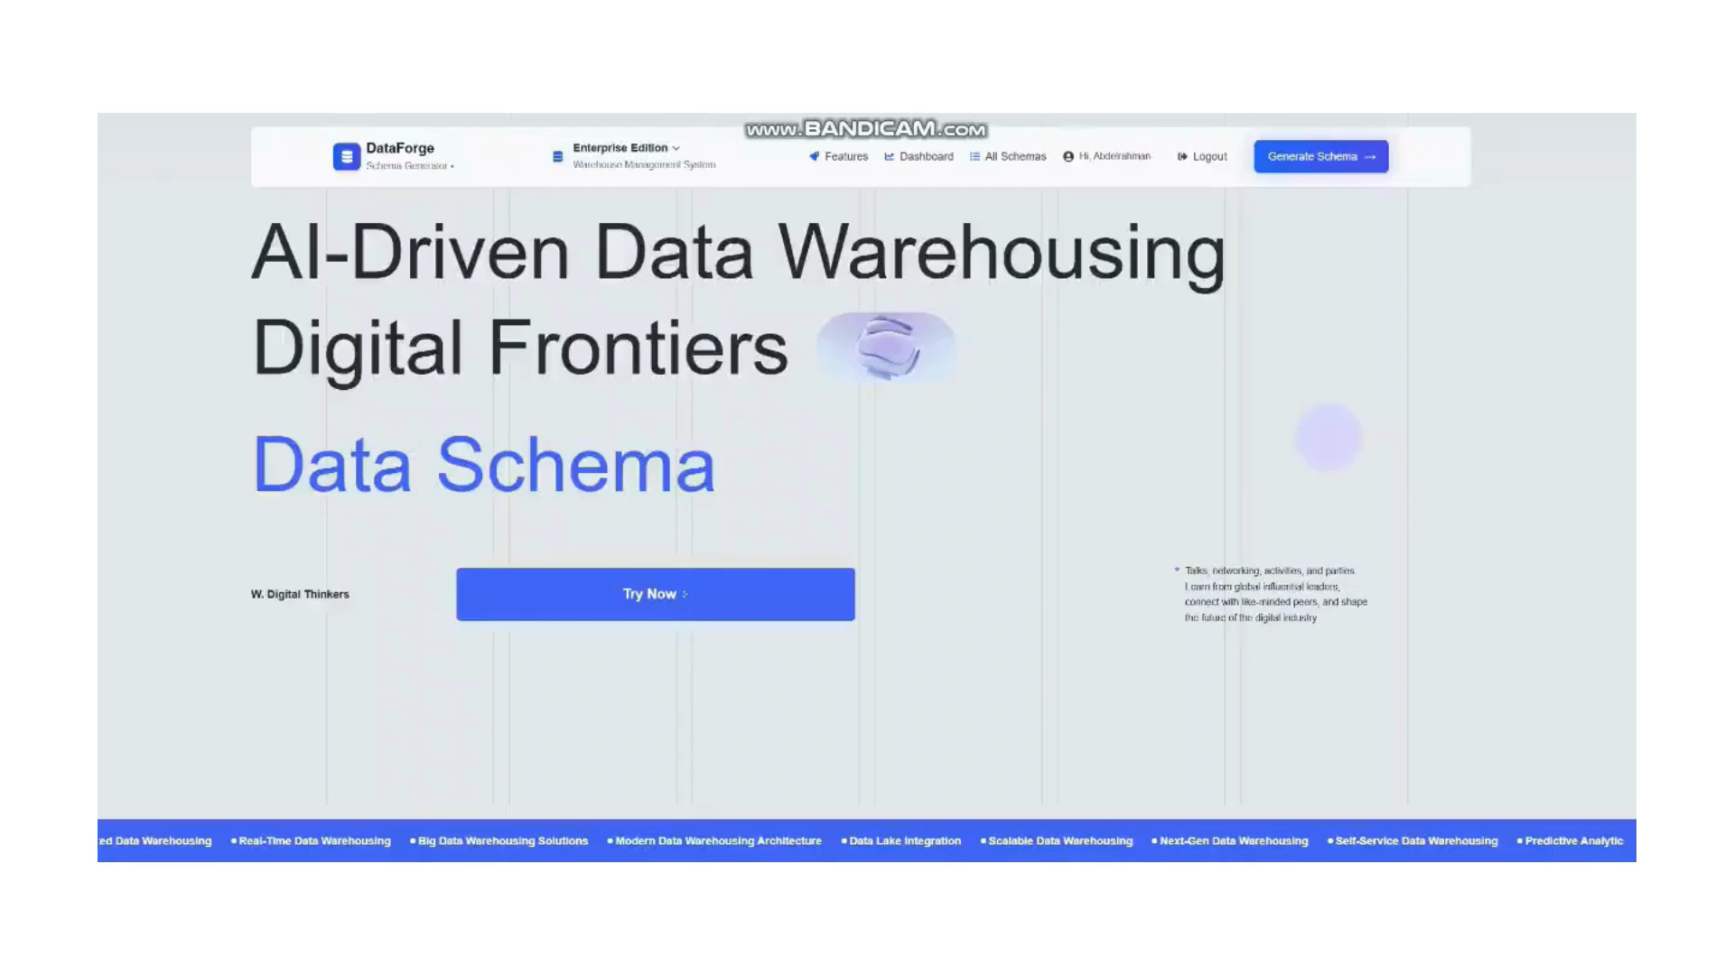
Demo
39

Slide 55

Any
Questions

Slide 56
Thank You

